Slide 1
Data Analytics with R Introduction and Data Structures in R
Presented By : Aditya Joshi
Asst. Professor
Department of Computer Application
Graphic Era Deemed to be University

Slide 2
Introduction to R
R is a programming language and environment commonly used in statistical computing, data analytics and scientific research.
It is one of the most popular languages used by statisticians, data analysts, researchers and marketers to retrieve, clean, analyze, visualize and present data.
R is freely available under the GNU General Public License, and pre-compiled binary versions are provided for various operating systems like Linux, Windows and Mac.
R is an Open Source (GPL) Statistical Environment modeled after S and S-Plus. The S language was developed in the late 1980’s at AT&T Labs.(S -> Statistical)
The R Project was Started by Robert Gentleman and Ross lhaka(Hence the name R) of the statistical department of the University of Auckland in 1995.

Slide 3
R is a
Programming Language
A statistical package
An interpreter
Open Source
Object Oriented Language.

Slide 4
R is a programming language and software environment for statistical Computing and Graphics Supported by the R Foundation for Statistical computing.
The R Language is widely used among Statisticians and data miners for developing statistical software and data analysis.
R is powerful statistical program but it is first and foremost a programming language. Many routines have been written for R by people all over the world and made freely available from the R project website as “packages” however the basic installation (for windows, Linux or Mac) contains a powerful set of tools for most purposes.

Slide 5
Features of R Programming Language
R is a programming language and software environment for statistical analysis, graphics representation and reporting. The following are the important features of R:
Well developed, simple and effective Programming language which includes conditional loops, user defined recursive functions and input and output facilities
R has an effective data handling and storage facility.
R provides a suite for operators for calculations on arrays, lists, vectors and matrices.
R provides a large, coherent and integrated collection of tools for data analysis

Slide 6
5. R provides graphical facilities for data analysis and display either directly at the computer or printing at the papers
6. As a conclusion, R is the most widely used statistical programming language.

Slide 7
Downloading and installing R
To Install R:
Open an internet browser and go to www.r-project.org.
Click the "download R" link in the middle of the page under "Getting Started."
Select a CRAN Comprehensive R Archive Network location (a mirror site) and click the corresponding link.
Click on the "Download R for Windows" link at the top of the page.
Click on the "install R for the first time" link at the top of the page.
Click "Download R for Windows" and save the executable file somewhere on your computer. Run the .exe file and follow the installation instructions.
Now that R is installed, you need to download and install RStudio.

Slide 8
To Install RStudio
Go to www.rstudio.com now https://posit.co/download/rstudio-desktop/ and click on the "Download RStudio" button.
Click on "Download RStudio Desktop."
Click on the version recommended for your system, or the latest Windows version, and save the executable file. Run the .exe file and follow the installation instructions.

Slide 9
RStudio: An Integrated Development Environment (IDE) for R
RStudio is an integrated development environment (IDE) that allows you to interact with R more readily. RStudio is similar to the standard RGui, but is considerably more user friendly. It has more drop-down menus, windows with multiple tabs, and many customization options. The first time you open RStudio, you will see three windows. A forth window is hidden by default, but can be opened by clicking the File drop-down menu, then New File, and then R Script.

Slide 10
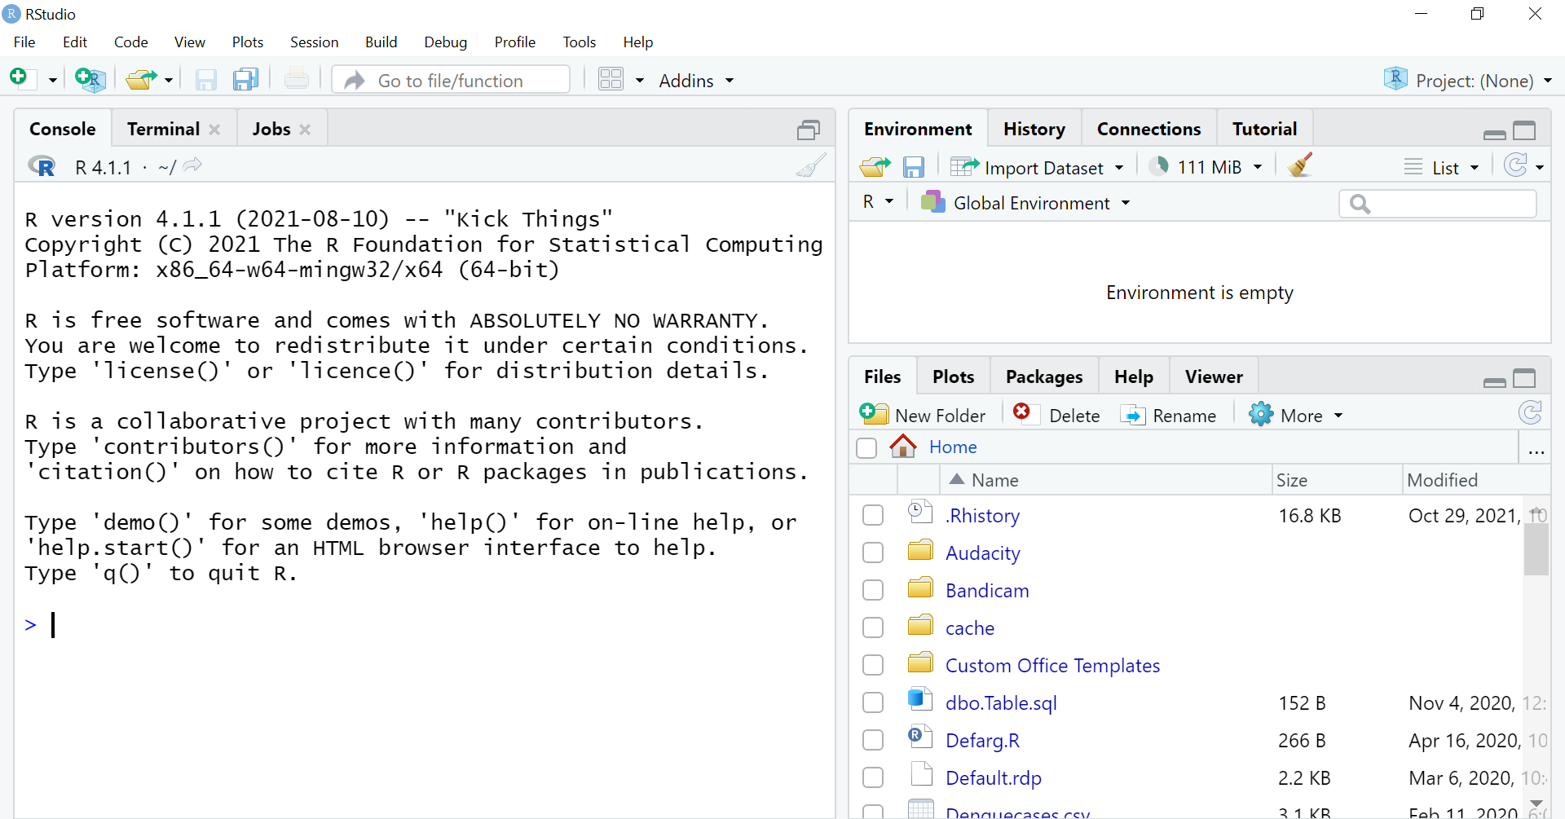

Slide 11
R Programming IDE and editors
R is a programming language meant for statistical computing and data science.
R can be run in the command line for terminal nerds and graphical user interfaces in integrated development environments.
1.RStudio
2.R Tools for Visual Studio
3.Rattle
4.StatET for R (Eclipse StatET)
5.ESS (Emacs Speaks Statistics)
6.Tinn-R
7. R AnalyticalFlow
8. Radiant
9.RBox
10. NVim-R
11. r4intelliJ

Slide 12
Alternatives to R programming
Python
SAS (Statistical Analysis System)
SPSS - Software package for statistical analysis

Slide 13
Getting Help with R
Helping Yourself
Before asking others for help, it’s generally a good idea for you to try to help yourself.
R includes extensive facilities for accessing documentation and searching for help.
There are also specialized search engines for accessing information about R on the internet, and general internet search engines can also prove useful.
Once R is installed, there is a comprehensive built-in help system. At the program's command prompt you can use any of the following:

Slide 14
R Help
You can get help from CRAN website and Internet
The Help Command In R
R contains a lot of built in help the basic command to bring up help is
help(topic)
For example help(mean)
You can use this also
?topic
For example ?mean
We also have the help.search() function to do a search engine type of search. We could use the ?? operator for this.
> help.search("histograms")
> ??"histograms"

Slide 15
You can also access the help system via your web browser by typing
help.start()
You can use following command if you don’t know the exact keyword The apropos command is used to identify R objects that contain a character string at least partially.(with reference to)
apropos(‘partword’)
For example apropos(‘plot’)
The find R function returns the location where objects of a given name can be found.
find("cdplot")
This method uses internet search engine for searching information
RSiteSearch("{generalized linear model}")
get vignettes on using installed packages
long form documentation of your package it contains HTML, pdf and original source
vignette()
browseVignettes(package=“packagename”)
demo(package=“packagename”)

Slide 16
Command Packages (over 10000 packages in CRAN)
The R Program is built from a series of modules, called packages.
Packages are bundles of code that add new functions to R
R packages are a collection of R functions, complied code and sample data.
They are stored under a directory called "library" in the R environment.
By default, R installs a set of packages during installation. More packages are added later, when they are needed for some specific purpose.

Slide 17
Check Available R Packages
search() this command is used to what package is loaded and ready to use it will Get all packages currently loaded in the R environment
Installed.packages() this command is to see what package are available
.libPaths() Get library locations containing R packages
library() Get the list of all the packages installed

Slide 18
Install a New Package
There are two ways for installing package One is installing directly from the CRAN directory and another is downloading the package to your local system and installing it manually.
1. Install directly from CRAN
By command install.packages(“packagename”) The following command gets the packages directly from CRAN webpage and installs the package in the R environment. You may be prompted to choose a nearest mirror. Choose the one appropriate to your location.
#install the package name XML
Install.packages(“XML”)
2. Install package manually
Go to this link https://cran.r-project.org/web/packages/available_packages_by_name.html

Slide 19
to download the package needed. Save the package as a .zip file in a suitable location in the local system.
Now you can run the following command to install this package in the R environment.
install.packages(file_name_with_path, repos = NULL, type = "source")
# Install the package named "XML"
install.packages("E:/XML_3.98-1.3.zip", repos = NULL, type = "source")
The other way is from package menu in r environment

Slide 20
Loading Package
Before a package can be used in the code, it must be loaded to the current R environment. You also need to load a package that is already installed previously but not available in the current environment.
A package is loaded using the following command −
library(packagename)

Slide 21
Removing and unloading packages
If you have loaded some packages and want to remove them command used is
detach(package:name)

Slide 22
Use R Like Calc
R can be used for doing simple mathematical calculations
By typing
> 2+3+4
[1]9
You can do bit more complicated calculations
Like
> 15+8/2*100
[1] 415

Slide 23
Some of the mathematical operations Available in R
Command / Operation | Explanation
+ - / * ( ) | Standard mathematical characters as well as parentheses
pi | Value of pi 3.142
x^y | X raised to the power y
sqrt(x) | Square root of x
abs(x) | Absolute value of x
factorial(x) | Factorial of x
cos(x),sin(x), acosx() etc | Trigonometric functions
exp(x) | Exponent of x
log10(x) log2(x) | Log of x to the base 2 and 10

Slide 24
Storing results for calculations
To make a result object simply type the name followed by equal sign and any thing after = will be evaluated and stored as your result.
> a=23+2
> b=22-1
sum=a+b
= sign or <- sign
Older version of R uses = sign
> a<-29/2
> b<-22/2
> mul<-a*b
> a+b->sum

Slide 25
Reading and Getting data into R
For creating more complex series of numbers to work on so that you will be able to use these complex series for further analysis
Using combine command for making data
For creating sample we have to use c() command
It is short for combine or concatenate
Every thing in parentheses joined up to make a single item
c(item.1, item.2, item.3,item.n)
You will assign joined up items to a named object
sample.name=c(item.1, item.2, item.3,item.n)

Slide 26
Entering Numerical items as data
data1=c(3,4,5,6,7,8,2,3,5)
If you want to see the result you must type its name
> data1
[1] 3 4 5 6 7 8 2 3 5
How long we can take data
> data1=c(1,2,3,4,5,6,7,8,9,10,11,12,13,14,15,16,17,18)
> data1
[1] 1 2 3 4 5 6 7 8 9 10 11 12 13 14 15 16 17
[18] 18

Slide 27
You can add data in at any point from previous data item stored in new data object
> data1=c(1,2,3,4,5)
> data1
[1] 1 2 3 4 5
> data2=c(data1,6,7,8,9)
> data2
[1] 1 2 3 4 5 6 7 8 9
> data3=c(10,20,data2)
> data3
[1] 10 20 1 2 3 4 5 6 7 8 9

Slide 28
Entering text items as data
You can use single or double quotes between data items for entering them as text
our.text=c(“item1”, “item2”,’item3’)
> day1=c("Mon", "Tue","Wed",'Thu','Fri',"Sat","Sun")
> day1
[1] "Mon" "Tue" "Wed" "Thu" "Fri" "Sat" "Sun"
> mix=c(data1,day1)
> mix
[1] "1" "2" "3" "4" "5" "Mon" "Tue" "Wed"
[9] "Thu" "Fri" "Sat" "Sun"

Slide 29
Using Scan Command for Making Data
our.data=scan() this will prompt for enter your data
> data1=scan() Numerical Data
1: 1
2: 2
3: 3
4:
Read 3 items
> data1
[1] 1 2 3

Slide 30
Entering Text as data
> day=scan(what='character')
1: Mon Tue Wed
4: Thu
5: fri
6: Sat
7: sun
8:
Read 7 items
> day
[1] "Mon" "Tue" "Wed" "Thu" "fri" "Sat" "sun"

Slide 31
Using the clipboard to make data
You can make scan() command easier to use than c() command because it does not require commas so we can easily copy from spreadsheet and paste data to R steps are:
1. If the data are in numbers type the command in R before switching to spreadsheet containing data
2. Highlight the cells and copy the data into clipboard
3. Return to R and paste the data from clipboard to R
4. Once you are finished enter black line to complete the data
If data is in character the add the what=‘character in the scan() command ’

Slide 32
If the data is separated with simple spaces , you can simply copy and paste.
If the data is separated with some other character then you need to tell R which character is used as the separator.
A common CSV file which uses commas to separate the data items
You have to use
scan(sep=‘,’)
If characters are there then
scan(sep=‘,’, what=‘char’)
> data=scan(sep=',',what='char')
1: Andhra Pradesh 2014 1262 5
2:
Read 1 item
> data
[1] "Andhra Pradesh\t2014\t1262\t5"
> data=scan(sep='\t',what='char')
1: Andhra Pradesh 2014 1262 5
5:
Read 4 items
> data
[1] "Andhra Pradesh" "2014" "1262"
[4] "5"

Slide 33
Reading a file of data from a disk
> data=scan(file='sample.txt', what='char')
Read 11 items
> data
[1] "aditya" "joshi" "this" "is" "a"
[6] "very" "good" "topic" "1" "2"
[11] "3"
R looks for data file in default directory so command is
> getwd()
[1] "C:/Users/Aditya/Documents"

Slide 34
If your file is in another location
> data=scan(file='C:/Users/Aditya/Desktop/sample.txt', what='char')
Read 11 items
> data
[1] "aditya" "joshi" "this" "is" "a"
[6] "very" "good" "topic" "1" "2"
[11] "3"
>

Slide 35
Setting working directory
You can alter working directory with setwd() command
> setwd('C:/Users/Aditya/Desktop')
> getwd()
[1] "C:/Users/Aditya/Desktop"
To set working directory one level up you can use
> setwd('..')
> getwd()
[1] "C:/Users/Aditya"
>

Slide 36
Looking the contents of directory
For checking the the contents of directory with files and folder are there
dir()
list.files() are used

Slide 37
> dir('Desktop')
[1] "AdityaJoshi_AssignmentML.pdf"
[2] "Client Authentication Agent.lnk"
[3] "CodeBlocks.lnk"
[4] "CPP"
[5] "CPPPrograms"
[6] "dengue"
[7] "desktop.ini"
[8] "Microsoft Edge.lnk"
[9] "MinGW Installer.lnk"
[10] "Paperstostudy"
[11] "R"
[12] "sample.txt"
[13] "Suspended.docx"

Slide 38
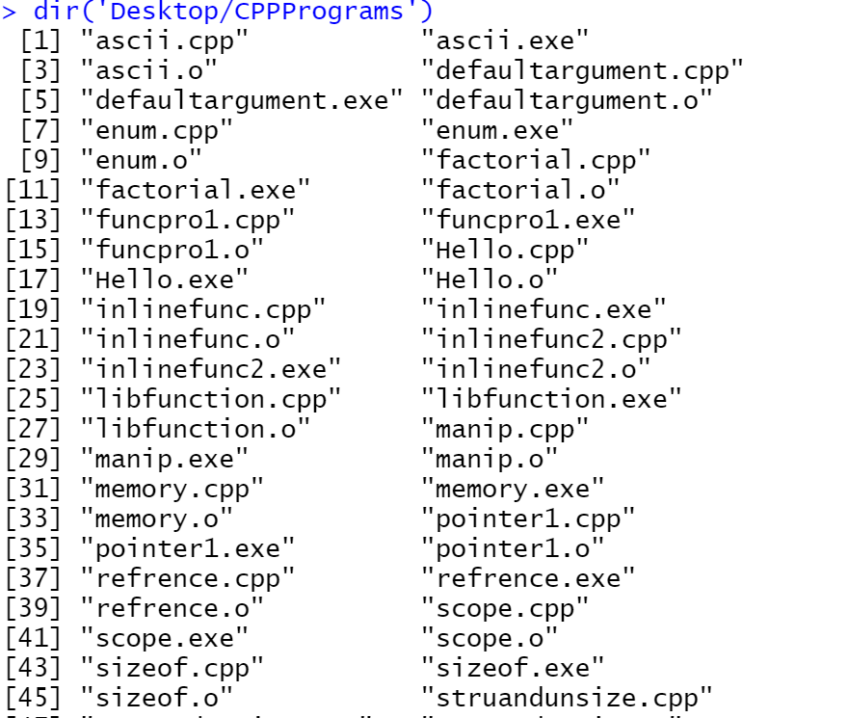

Slide 39
> list.files('DEsktop')
[1] "AdityaJoshi_AssignmentML.pdf"
[2] "Client Authentication Agent.lnk"
[3] "CodeBlocks.lnk"
[4] "CPP"
[5] "CPPPrograms"
[6] "dengue"
[7] "desktop.ini"
[8] "Microsoft Edge.lnk"
[9] "MinGW Installer.lnk"
[10] "Paperstostudy"
[11] "R"
[12] "sample.txt"
[13] "Suspended.docx"
>

Slide 40
For invisible files
> dir(all.files = TRUE)
[1] "." ".."
[3] ".Rhistory" "Custom Office Templates"
[5] "desktop.ini" "My Music"
[7] "My Pictures" "My Videos"
[9] "Python Scripts" "R"
[11] "sample.txt"
>

Slide 41
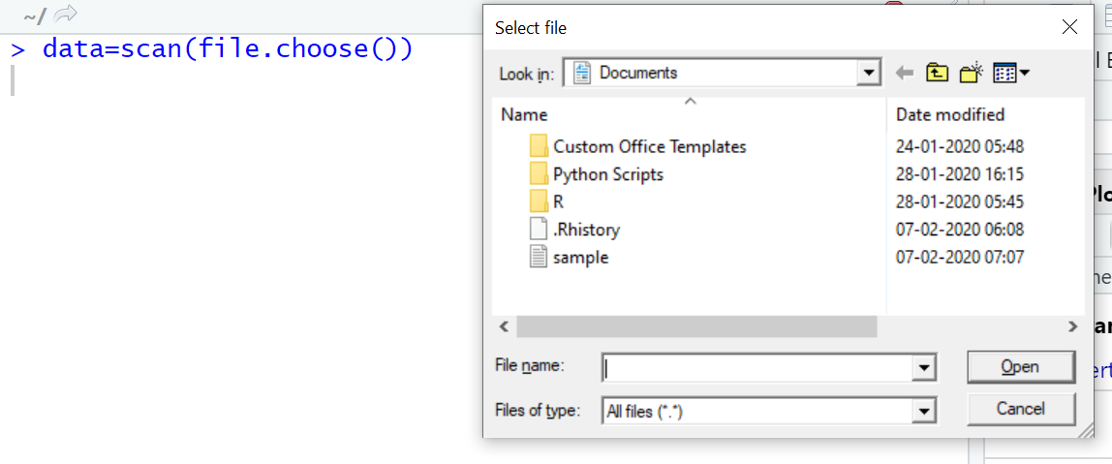
Selects the file from browser type or from popup window
>data=scan(file.choose())
> data=scan(file.choose(),what='char')
Read 11 items
> data
[1] "aditya" "joshi" "this" "is" "a"
[6] "very" "good" "topic" "1" "2"
[11] "3"
>

Slide 42
Reading Bigger Files
Scan command is helpful to read simple vector for reading the more complicated files having multiple items i.e two dimensional in nature containing rows and columns
In most cases you have to prepare data in spreadsheet for reading data from spreadsheet command read.csv() is used it is under utils package

Slide 43
> read.csv("Denguecases.csv")
StateUT Year Cases Deaths
1 Andhra Pradesh 2014 1262 5
2 Arunachal Pradesh 2014 27 0
3 Assam 2014 85 0
4 Bihar 2014 297 0
> read.csv("Denguecases.csv", header=TRUE)
StateUT Year Cases Deaths
1 Andhra Pradesh 2014 1262 5
2 Arunachal Pradesh 2014 27 0
3 Assam 2014 85 0
4 Bihar 2014 297 0

Slide 44
> read.csv("Denguecases.csv", header=FALSE)
V1 V2 V3 V4
1 StateUT Year Cases Deaths
2 Andhra Pradesh 2014 1262 5
Arunachal Pradesh 2014 27 0
> read.csv("Denguecases.csv", header=TRUE, row.names=NULL,col.names=c("a","b","c","d"))
a b c d
1 Andhra Pradesh 2014 1262 5
2 Arunachal Pradesh 2014 27 0
3 Assam 2014 85 0

Slide 45
If you have file saved in .XLS or .xlsx format save the data as CSV format. For making the columns together in R for making it single entity.
You can read the file with the help of searching it by the browser window.
> fw=read.csv(file.choose())
> fw
StateUT Year Cases Deaths
1 Andhra Pradesh 2014 1262 5
2 Arunachal Pradesh 2014 27 0
3 Assam 2014 85 0
4 Bihar 2014 297 0
5 Chhattisgarh 2014 440 9

Slide 46
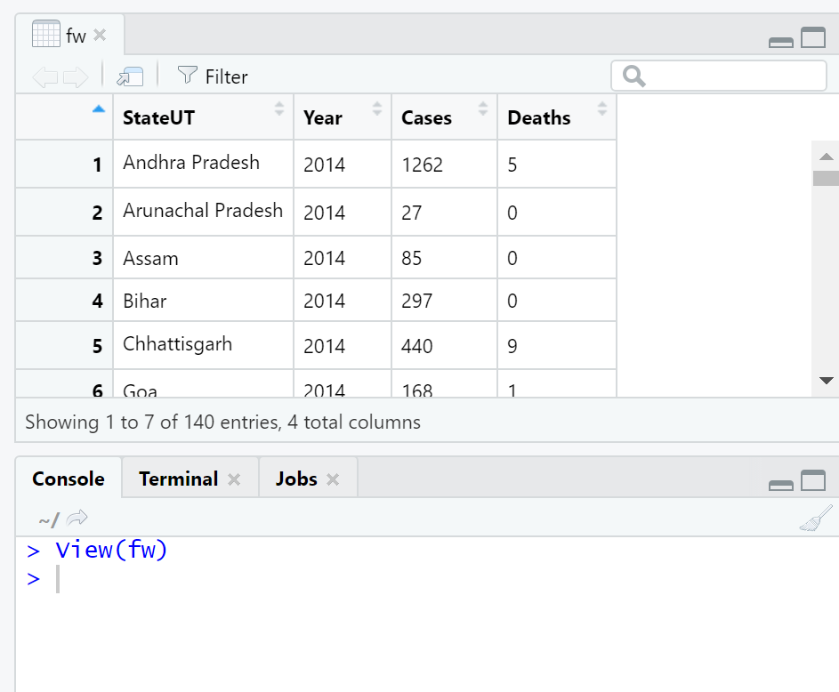

Slide 47
Alternative command for Reading Data in R
> read.table(file.choose(),sep=',',header = TRUE)
StateUT Year Cases Deaths
1 Andhra Pradesh 2014 1262 5
Arunachal Pradesh 2014 27 0
Defaults: header=FALSE, sep=“ “ single space, dec=“.”
dec the character used in the file for decimal points.
> read.delim(file.choose()) for tab sep values
StateUT.Year.Cases.Deaths
1 Andhra Pradesh,2014,1262,5
Arunachal Pradesh,2014,27,0

Slide 48
> read.csv2(file.choose())
StateUT.Year.Cases.Deaths
1 Andhra Pradesh,2014,1262,5
Arunachal Pradesh,2014,27,0
Defaults: sep=“;”, header=TRUE, and dec=“,”

Slide 49
Missing Values in data files
Missing Values in data file usually denoted by NA
> fw=read.csv(file.choose())
> fw
StateUT Year Cases Deaths
1 Andhra Pradesh 2014 1262 5
2 Arunachal Pradesh 2014 27 0
3 Assam 2014 NA 0
4 Bihar 2014 297 0
5 Chhattisgarh 2014 440 9

Slide 50
Viewing named object
> data2=c(2,3,4,6,7)
> data1=2+3+4
> fw=read.csv(file.choose())
data2, data1, fw are named object

Slide 51
Viewing previously loaded named object
> ls()
[1] "data1" "data2" "fw"
ls() command is used to list all the named items available
Viewing only Matching name by search pattern
> ls(pattern = 'd')
[1] "data1" "data2«
>ls(pattern='^d’) starting from d

Slide 52
Removing object from R
You can remove objects from memory and therefore permanently delete them using the rm() or remove() command
> rm(data1,data2,fw)
> data1
Error: object 'data1' not found
> data1=2+3+4
> data2=c(2,3,4,6,7)
> fw=read.csv(file.choose())
> rm(list=ls(pattern='d'))
> ls()
[1] "fw“
>rm(list=ls()) for all the objects

Slide 53
Types of data Items
Number Data
Plain Values that are whole numbers are integers values. Values that contain decimals are numeric.
In R integers and decimals entire sample are treated as numeric
> data2
[1] 2 3 4 6 7
> data3
[1] 2.1 12.5 11.0 22.1

Slide 54
Text Items
R is having two sorts of text data items
Plain Text labels these are called character values Plain Text and the quote marks to remind you .
> data
[1] "Mon" "Tue" "Wed" "Thur" "Fri" "Sat"
Plain Text without quote marks is called factor .
> data=factor(c("single","married","single","single","married"))
> data
[1] single married single single married
Levels: married single

Slide 55
Converting between number and Text Data
as.character(): convert to plain text
> data1=as.character(data)
> data1
[1] "single" "married" "single" "single" "married“
as.factor(): plain text to factor
> data2=as.factor(data1)
> data2
[1] single married single single married
Levels: married single

Slide 56
as.integer(): decimal(numeric) to integers
> data3
[1] 2.1 12.5 11.0 22.1
> data1=as.integer(data3)
> data1
[1] 2 12 11 22
as.numeric(): integers to numeric
> data=c(1,2,4,5,7,8)
> data
[1] 1 2 4 5 7 8
> data1=as.numeric(data)
> data1
[1] 1 2 4 5 7 8

Slide 57
The Structure of Data Items
There are various data structures associated with R
Vector
Matrix
Data Frame
List
Factor

Slide 58
Vector
Vector is a basic data structure in R. It contains element of the same type. The data types can be logical, integer, double, character, complex or raw.
A vector’s type can be checked with the typeof() function.
Another important property of a vector is its length. This is the number of elements in the vector and can be checked with the function length().
It can be thought of a One Dimensional Object

Slide 59
How to Create Vector
Vectors are generally created using the c() function.
Since, a vector must have elements of the same type, this function will try and coerce elements to the same type, if they are different.
Coercion is from lower to higher types from logical to integer to double to character.
> x <- c(1, 5, 4, 9, 0)
> typeof(x)
[1] "double"
> length(x)
[1] 5
> x1 <- c(1, 5.4, TRUE, "hello")
> x1
[1] "1" "5.4" "TRUE" "hello"
> typeof(x1)
[1] "character"

Slide 60
Creating a vector using : operator
If we want to create a vector of consecutive numbers, the : operator is very helpful.
> x <- 1:7; x
[1] 1 2 3 4 5 6 7

Slide 61
Creating a vector using seq() function
More complex sequences can be created using the seq() function, like defining number of points in an interval, or the step size.
> seq(1, 3, by=0.2
+ )
[1] 1.0 1.2 1.4 1.6 1.8 2.0 2.2 2.4 2.6 2.8 3.0
> seq(1, 5, length.out=4)
[1] 1.000000 2.333333 3.666667 5.000000
From
To
by : difference b/w the elements
length.out: max length of the vector Generating Sequence from X to Y with Given Length
along.with Generating Sequence from X to Y Along Certain Data Object

Slide 62
How to access Elements of a Vector?
Elements of a vector can be accessed using vector indexing. The vector used for indexing can be logical, integer or character vector.
Using integer vector as index
Vector index in R starts from 1, unlike most programming languages where index start from 0.
We can use a vector of integers as index to access specific elements.
We can also use negative integers to return all elements except that those specified.
But we cannot mix positive and negative integers while indexing and real numbers, if used, are truncated to integers.

Slide 63
> x
[1] 1 2 3 4 5 6 7
> x[3] access 3rd element
[1] 3
> x[c(2, 4)] access 2nd and 4th element
[1] 2 4
> x[-1] access all element except 1
[1] 2 3 4 5 6 7
> x[c(2, -4)]
Error in x[c(2, -4)] : only 0's may be mixed with negative subscripts
> x[c(2.4, 3.54)] real converted to integers
[1] 2 3

Slide 64
Using logical vector as index
When we use a logical vector for indexing, the position where the logical vector is TRUE is returned.
y<-c(1,2,3)
> y[c(TRUE,FALSE,FALSE)]
[1] 1
> y
[1] 1 2 3
Using character vector as index
This type of indexing is useful when dealing with named vectors. We can name each elements of a vector.

Slide 65
> x <- c("first"=3, "second"=0, "third"=9)
> x
first second third
3 0 9
> x["second"]
second
0
> x[c("first", "third")]
first third
3 9

Slide 66
How to modify a vector in R?
We can modify a vector using the assignment operator.
We can use the techniques discussed above to access specific elements and modify them.
If we want to truncate the elements, we can use reassignments.

Slide 67
> x=c(1,2,3,4,5,6)
> x
[1] 1 2 3 4 5 6
> x[2] <- 0; x
[1] 1 0 3 4 5 6
> x[x<0] <- 5; x
[1] 1 0 3 4 5 6
> x[x<4] <- 5; x
[1] 5 5 5 4 5 6
> x <- x[1:4]; x // truncate x to first 4 elements
[1] 5 5 5 4

Slide 68
How to delete a Vector?
We can delete a vector by simply assigning a NULL to it.
[1] 5 5 5 4
> x
[1] 5 5 5 4
> x <- NULL
> x[4]
NULL
Individual elements
x <- c(10, 20, 30, 40, 50)
indices <- c(4)
result <- x[-indices]
print(result)

Slide 69
How to find the index of the vector
Every element in the vector has a particular position or index. It is possible to know the index of any element using built-in functions in R like which(), and match().
The which() function returns a vector with the index (or indexes) of the element which matches the logical vector (in this case ==).
> x<-c(2,3,5,3,5,6,5,8)
> which(x==5)
[1] 3 5 7
The match() function is very similar to the which() function. It returns a vector with the first index (if the element is at more than one position as in our case) of the element and is considered faster than the which() function.
> match(5,x)
[1] 3
> match(c(3,5),x)
[1] 2 3

Slide 70
Notice that since 5 is present thrice in the vector, all of its positions are returned. If we want the first index of 5
> which(x==5)[1]
[1] 3
> which(x==5)[2]
[1] 5
> which(x==5)[3]
[1] 7
We can also use the which() function to find the indexes of multiple elements using the %in% parameter, which returns a vector with a True value for every element that matches.
> which(x %in% c(3,5))
[1] 2 3 4 5 7

Slide 71
Creating Sample series
> sample(1:10)
[1] 5 8 6 2 3 7 9 10 4 1
> x <- sample(1:4,10,replace=TRUE)
> x
[1] 2 2 1 2 4 1 4 2 4 4

Slide 72
R Lists
List is a data structure having components of mixed data types.
A vector having all elements of the same type is called atomic vector but a vector having elements of different type is called list.
We can check if it’s a list with typeof() function and find its length using length(). Here is an example of a list having three components each of different data type.
> x
$a
[1] 2.5
$b
[1] TRUE
$c
[1] 1 2 3
> typeof(x)
[1] "list"
> length(x)
[1] 3

Slide 73
How to create a list in R programming?
List can be created using the list() function.
> x <- list("a" = 2.5, "b" = TRUE, "c" = 1:3)
Here, we create a list x, of three components with data types double, logical and integer vector respectively.
> x
$a
[1] 2.5
$b
[1] TRUE
$c
[1] 1 2 3
Its structure can be examined with the str() function.
> str(x)
List of 3
$ a: num 2.5
$ b: logi TRUE
$ c: int [1:3] 1 2 3

Slide 74
In this example, a, b and c are called tags which makes it easier to reference the components of the list.
However, tags are optional. We can create the same list without the tags as follows. In such scenario, numeric indices are used by default.
> x <- list(2.5,TRUE,1:3)
> x
[[1]]
[1] 2.5
[[2]]
[1] TRUE
[[3]]
[1] 1 2 3

Slide 75
How to access components of a list?
Lists can be accessed in similar fashion to vectors. Integer, logical or character vectors can be used for indexing.
> x[c(1:2)] # index using integer vector
[[1]]
[1] 2.5
[[2]]
[1] TRUE
> x[-2] # exclude second component
[[1]]
[1] 2.5
[[2]]
[1] 1 2 3
> x[c(T,F,F)] #using logical operator
[[1]]
[1] 2.5

Slide 76
> x <- list("a" = 2.5, "b" = TRUE, "c" = 1:3)
> x[c("a","b")]
$a
[1] 2.5
$b
[1] TRUE
> x["a"]
$a
[1] 2.5
> typeof(x["a"])
[1] "list"
> x[["a"]]
[1] 2.5
> typeof(x[["a"]])
[1] "double"

Slide 77
How to modify a list in R?
We can change components of a list through reassignment. We can choose any of the component accessing techniques discussed above to modify it.
> x<-list("name" = "Aditya", "age" = 35, "speaks" =c("english", "french"))
> x
$name
[1] "Aditya"
$age
[1] 35
$speaks
[1] "english" "french"

Slide 78
> x[["name"]] <- "ABC"; x
$name
[1] "ABC"
$age
[1] 35
$speaks
[1] "english" "french"

Slide 79
How to add components to a list?
Adding new components is easy. We simply assign values using new tags and it will pop into action.
> x[["married"]] <- TRUE
> x
$name
[1] "ABC"
$age
[1] 35
$speaks
[1] "english" "french"
$married
[1] TRUE
Notes:
append(after = 0)

Slide 80
How to delete components from a list?
We can delete a component by assigning NULL to it.
> x[["age"]] <- NULL
> str(x)
List of 3
$ name : chr "ABC"
$ speaks : chr [1:2] "english" "french"
$ married: logi TRUE
> x$married<-NULL
> str(x)
List of 2
$ name : chr "ABC"
$ speaks: chr [1:2] "english" "french"

Slide 81
Data Frames
Data frame is a two dimensional data structure in R. It is a special case of a list which has each component of equal length.
Each component form the column and contents of the component form the rows.
Create a Data Frame in R
We can create a data frame using the data.frame() function.
> x <- data.frame("SN" = 1:2, "Age" = c(21,15), "Name" = c("Sunil","Santosh"))
> str(x)
'data.frame': 2 obs. of 3 variables:
$ SN : int 1 2
$ Age : num 21 15
$ Name: chr "Santosh","Sunil"

Slide 82
stringsAsFactors=TRUE.
> x <- data.frame("SN" = 1:2, "Age" = c(21,15), "Name" = c("Anand", "Harshit"),stringsAsFactors = TRUE)
> str(x)
'data.frame': 2 obs. of 3 variables:
$ SN : int 1 2
$ Age : num 21 15
$ Name: Factor w/ 2 levels "Anand","Harshit": 1 2

Slide 83
> x
SN Age Name
1 1 21 Anand
2 2 15 Harshit
> typeof(x)
[1] "list"
> class(x)
[1] "data.frame“
Functions of data frame
> names(x)
[1] "SN" "Age" "Name"
> ncol(x)
[1] 3
> nrow(x)
[1] 2
> length(x) # returns length of the list, same as ncol()
[1] 3

Slide 84
Many data input functions of R like, read.table(), read.csv(), read.delim(), read.fwf() also read data into a data frame.
How to access Components of a Data Frame?
Components of data frame can be accessed like a list or like a matrix.
Accessing like a list
We can use either [, [[ or $ operator to access columns of data frame.
Accessing with [[ or $ is similar. However, it differs for [ in that, indexing with [ will return us a data frame but the other two will reduce it into a vector.
> x["Name"]
Name
1 Anand
2 Harshit
> x$Name
[1] "Anand" "Harshit“
> x[["Name"]]
[1] "Anand" "Harshit"
> x[[3]]
[1] "Anand" "Harshit"

Slide 85
Accessing like a matrix
Data frames can be accessed like a matrix by providing index for row and column. To illustrate this, we use datasets already available in R. Datasets that are available can be listed with the command library(help = "datasets"). We will use the trees dataset which contains Girth, Height and Volume for Black Cherry Trees.
> str(trees)
'data.frame': 31 obs. of 3 variables:
$ Girth : num 8.3 8.6 8.8 10.5 10.7 10.8 11 11 11.1 11.2 ...
$ Height: num 70 65 63 72 81 83 66 75 80 75 ...
$ Volume: num 10.3 10.3 10.2 16.4 18.8 19.7 15.6 18.2 22.6 19.9 ...
> head(trees,n=3)
Girth Height Volume
1 8.3 70 10.3
2 8.6 65 10.3
3 8.8 63 10.2
> tail(trees,n=3)
Girth Height Volume
29 18.0 80 51.5
30 18.0 80 51.0
31 20.6 87 77.0

Slide 86
We can see that trees is a data frame with 31 rows and 3 columns. We also display the first 3 rows of the data frame.
> trees[2:3,] #Selects Second and third row with all data
Girth Height Volume
2 8.6 65 10.3
3 8.8 63 10.2
> trees[trees$Height > 82,] # selects rows with Height greater than 82 all data
Girth Height Volume
6 10.8 83 19.7
17 12.9 85 33.8
18 13.3 86 27.4
31 20.6 87 77.0
> trees[10:12,2] # only Height will be retrieved
[1] 75 79 76
We can see in the last case that the returned type is a vector since we extracted data from a single column.
This behavior can be avoided by passing the argument drop=FALSE as follows.
> trees[10:12,2, drop = FALSE]
Height
10 75
11 79
12 76

Slide 87
How to modify a Data Frame in R?
Data frames can be modified like we modified matrices through reassignment.
> x
SN Age Name
1 1 21 Anand
2 2 15 Harshit
> x[1,"Age"] <- 20; x
SN Age Name
1 1 20 Anand
2 2 15 Harshit

Slide 88
Adding Components
Rows can be added to a data frame using the rbind() function.
> rbind(x,list(1,16,"Riya"))
SN Age Name
1 1 20 Anand
2 2 15 Harshit
3 1 16 Riya
Similarly, we can add columns using cbind().
> cbind(x,City=c("Dehradun","New Delhi"))
SN Age Name City
1 1 20 Anand Dehradun
2 2 15 Harshit New Delhi
Since data frames are implemented as list, we can also add new columns through simple list-like assignments.
> x$City <- c("New Delhi","Dehradun"); x
SN Age Name City
1 1 20 Anand New Delhi
2 2 15 Harshit Dehradun

Slide 89
Deleting Component
Data frame columns can be deleted by assigning NULL to it.
> x$City <- NULL
> x
SN Age Name
1 1 20 Anand
2 2 15 Harshit
Similarly, rows can be deleted through reassignments.
> x <- x[-1,]
> x
SN Age Name
2 2 15 Harshit

Slide 90
R Factors
Factor is a data structure used for fields that takes only predefined, finite number of values (categorical data). For example: a data field such as marital status may contain only values from single, married, separated, divorced, or widowed.
In such case, we know the possible values beforehand and these predefined, distinct values are called levels.

Slide 91
How to create a factor in R?
We can create a factor using the function factor(). Levels of a factor are inferred from the data if not provided.
> x <- factor(c("single", "married", "married", "single"));
> x
[1] single married married single
Levels: married single
> x <- factor(c("single", "married", "married", "single"), levels = c("single", "married", "divorced"));
> x
[1] single married married single
Levels: single married divorced
levels may be predefined even if not used.

Slide 92
factors are stored as integer vectors.it is seen by checking from its structure
> x <- factor(c("single","married","married","single"))
> str(x)
Factor w/ 2 levels "married","single": 2 1 1 2
How to access components of a factor?
> x[3] #Third Element
[1] married
Levels: married single
> x[c(2, 4)] #second and fourth Element
[1] married single
Levels: married single
> x[-1] #all element except 1
[1] married married single
Levels: married single
> x[c(TRUE, FALSE, FALSE, TRUE)] #using logical vector
[1] single single
Levels: married single

Slide 93
How to modify a factor?
Components of a factor can be modified using simple assignments. However, we cannot choose values outside of its predefined levels.
> x
[1] single married married single
Levels: single married divorced
> x[2] <- "divorced“ #Modify Second Element
> x
[1] single divorced married single
Levels: single married divorced
> x[3] <- "widowed“ #Cannot Assign Values outside levels
Warning message:
In `[<-.factor`(`*tmp*`, 3, value = "widowed") :
invalid factor level, NA generated

Slide 94
Adding value to levels first
> levels(x) <- c(levels(x), "widowed")
> x
[1] single divorced <NA> single
Levels: single married divorced widowed
> x[3] <- "widowed"
> x
[1] single divorced widowed single
Levels: single married divorced widowed

Slide 95
R Matrix
Matrix is a two dimensional data structure in R programming.
Matrix is similar to vector but additionally contains the dimension attribute. All attributes of an object can be checked with the attributes() function (dimension can be checked directly with the dim() function).
We can check if a variable is a matrix or not with the class() function.

Slide 96
How to create a matrix in R programming?
Matrix can be created using the matrix() function.
Dimension of the matrix can be defined by passing appropriate value for arguments nrow and ncol.
Providing value for both dimension is not necessary. If one of the dimension is provided, the other is inferred from length of the data.

Slide 97
> matrix(1:9,nrow=3,ncol=3)
[,1] [,2] [,3]
[1,] 1 4 7
[2,] 2 5 8
[3,] 3 6 9
> matrix(1:9,nrow=3)
[,1] [,2] [,3]
[1,] 1 4 7
[2,] 2 5 8
[3,] 3 6 9
> matrix(c(3,4,5,4,2,3,4,5,7),nrow=3,ncol=3)
[,1] [,2] [,3]
[1,] 3 4 4
[2,] 4 2 5
[3,] 5 3 7

Slide 98
We can see that the matrix is filled column-wise. This can be reversed to row-wise filling by passing TRUE to the argument byrow.
> matrix(1:9,nrow=3,byrow=TRUE) # fill matrix row-wise
[,1] [,2] [,3]
[1,] 1 2 3
[2,] 4 5 6
[3,] 7 8 9
It is possible to name the rows and columns of matrix during creation by passing a 2 element list to the argument dimnames.
> matrix(1:9,nrow=3,dimnames=list(c("X","Y","Z"),c("A","B","C")))
A B C
X 1 4 7
Y 2 5 8
Z 3 6 9

Slide 99
These names can be accessed or changed with two helpful functions colnames() and rownames().
> X<-matrix(1:9,nrow=3,dimnames=list(c("X","Y","Z"),c("A","B","C")))
> colnames(X)
[1] "A" "B" "C“
> rownames(X)
[1] "X" "Y" "Z“
> colnames(X)<-c("C1","C2","C3")
> rownames(X)<-c("R1","R2","R3")
> X
C1 C2 C3
R1 1 4 7
R2 2 5 8
R3 3 6 9

Slide 100
Another way of creating a matrix is by using functions cbind() and rbind() as in column bind and row bind.
> cbind(c(1,2,3),c(4,5,6))
[,1] [,2]
[1,] 1 4
[2,] 2 5
[3,] 3 6
> rbind(c(1,2,3),c(4,5,6))
[,1] [,2] [,3]
[1,] 1 2 3
[2,] 4 5 6

Slide 101
Finally, you can also create a matrix from a vector by setting its dimension using dim().
> x <- c(1,2,3,4,5,6)
> x
[1] 1 2 3 4 5 6
> class(x)
[1] "numeric"
> dim(x)<-c(2,3)
> x
[,1] [,2] [,3]
[1,] 1 3 5
[2,] 2 4 6
> class(x)
[1] "matrix"

Slide 102
How to access Elements of a matrix?
We can access elements of a matrix using the square bracket [ indexing method. Elements can be accessed as var[row, column]. Here rows and columns are vectors.
Using integer vector as index
We specify the row numbers and column numbers as vectors and use it for indexing.
If any field inside the bracket is left blank, it selects all.
We can use negative integers to specify rows or columns to be excluded.
An element at the m^{th} row, n^{th} column of A can be accessed by the expression A[m, n].

Slide 103
> x
[,1] [,2] [,3]
[1,] 1 4 7
[2,] 2 5 8
[3,] 3 6 9
> x
[,1] [,2] [,3]
[1,] 1 4 7
[2,] 2 5 8
[3,] 3 6 9
> x[2,3] #Select 2nd row and 3rd col
[1] 8
> x[c(1,2),c(2,3)] # select rows 1 & 2 and columns 2 & 3
[,1] [,2]
[1,] 4 7
[2,] 5 8
> x[c(3,2),] # selects 3rd and 2nd row
[,1] [,2] [,3]
[1,] 3 6 9
[2,] 2 5 8

Slide 104
> x[,]
[,1] [,2] [,3]
[1,] 1 4 7
[2,] 2 5 8
[3,] 3 6 9
> x[-1,]
[,1] [,2] [,3]
[1,] 2 5 8
[2,] 3 6 9
if the matrix returned after indexing is a row matrix or column matrix, the result is given as a vector.
> x[1,]
[1] 1 4 7
> class(x[1,])
[1] "integer"

Slide 105
This behavior can be avoided by using the argument drop = FALSE while indexing.
> x[1,,drop=FALSE]
[,1] [,2] [,3]
[1,] 1 4 7
> class(x[1,,drop=FALSE])
[1] "matrix“
It is possible to index a matrix with a single vector.
While indexing in such a way, it acts like a vector formed by stacking columns of the matrix one after another. The result is returned as a vector.
> x
[,1] [,2] [,3]
[1,] 1 4 7
[2,] 2 5 8
[3,] 3 6 9
> x[1:4]
[1] 1 2 3 4
> x[c(3,5,7)]
[1] 3 5 7

Slide 106
Using logical vector as index
x[c(TRUE,FALSE,TRUE),c(TRUE,TRUE,FALSE)]
[,1] [,2]
[1,] 1 4
[2,] 3 6
x[c(TRUE,FALSE),c(2,3)]
X[c(1,3),c(2,3)]
[,1] [,2]
[1,] 4 7
[2,] 6 9

Slide 107
> x[x>5] #Select elements greater then 5
[1] 6 7 8 9
> x[x%%2 == 0] #Select even elements
[1] 2 4 6 8

Slide 108
Using character vector as index
Indexing with character vector is possible for matrix with named row or column. This can be mixed with integer or logical indexing.
> X
C1 C2 C3
R1 1 4 7
R2 2 5 8
R3 3 6 9
> X[,"C1"]
R1 R2 R3
1 2 3
> X[TRUE,c("C1","C3")]
C1 C3
R1 1 7
R2 2 8
R3 3 9
> X[2:3,c("C1","C3")]
C1 C3
R2 2 8
R3 3 9

Slide 109
How to modify a matrix in R?
We can combine assignment operator with the above learned methods for accessing elements of a matrix to modify it.
> x
[,1] [,2] [,3]
[1,] 1 4 7
[2,] 2 5 8
[3,] 3 6 9
> x[2,2] <- 10; x
[,1] [,2] [,3]
[1,] 1 4 7
[2,] 2 10 8
[3,] 3 6 9
> x[x<5] <- 0; x
[,1] [,2] [,3]
[1,] 0 0 7
[2,] 0 10 8
[3,] 0 6 9

Slide 110
A common operation with matrix is to transpose it. This can be done with the function t().
> t(x)
[,1] [,2] [,3]
[1,] 0 0 0
[2,] 0 10 6
[3,] 7 8 9
We can add row or column using rbind() and cbind() function respectively. Similarly, it can be removed through reassignment.

Slide 111
> cbind(x, c(1, 2, 3)) #Add COL
[,1] [,2] [,3] [,4]
[1,] 0 0 7 1
[2,] 0 10 8 2
[3,] 0 6 9 3
> rbind(x,c(1,2,3)) #ADD Row
[,1] [,2] [,3]
[1,] 0 0 7
[2,] 0 10 8
[3,] 0 6 9
[4,] 1 2 3
> x <- x[1:2,]; x #Remove Last Row
[,1] [,2] [,3]
[1,] 0 0 7
[2,] 0 10 8

Slide 112
Dimension of matrix can be modified as well, using the dim() function.
> x
[,1] [,2] [,3]
[1,] 0 0 7
[2,] 0 10 8
> dim(x) <- c(3,2); x #3*2 Matrix
[,1] [,2]
[1,] 0 10
[2,] 0 7
[3,] 0 8
> dim(x) <- c(1,6); x #1*6 Matrix
[,1] [,2] [,3] [,4] [,5] [,6]
[1,] 0 0 0 10 7 8
> c(x) #deconstruction of matrix
[1] 1 2 3 4 5 6 7 8 9

